Slide 1
Operating system
By Ayan Gupta
1RN23IS037

Slide 2
Allocation methods
performance

Slide 3
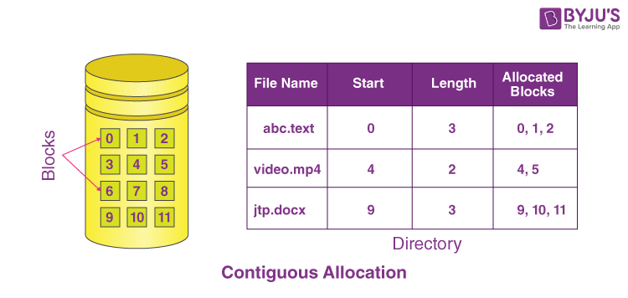
Contiguous Allocation
Requires only one access to retrieve a disk block.
Starting address of the file is saved in memory, making it easy to directly calculate the addresses of the file's blocks.
Efficient for both sequential and direct access

Slide 4
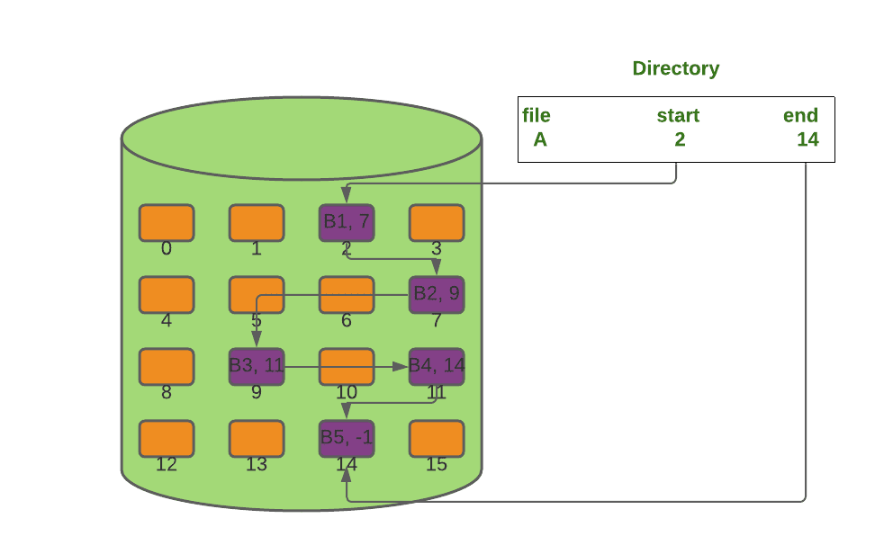
Linked Allocation
Stores the address of the next block in memory.
Works well for sequential access.
Direct access can be slow because requires multiple reads for the desired block.

Slide 5
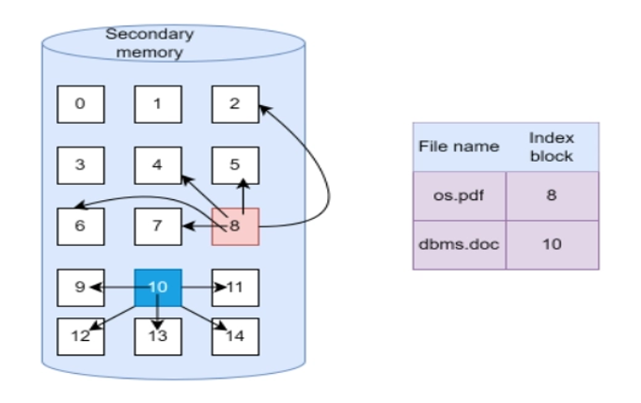
Indexed Allocation
Uses an index block to locate data.
Direct access is quick if the index block is in memory.
Large file takes longer to access.

Slide 6
Conclusion
Each allocation method has strengths and weaknesses
Contiguous Allocation: Fast and efficient for small files.
Linked Allocation: Ideal for sequential access.
Indexed Allocation: Better for larger files but needs more memory memory.

Slide 7
Thank YOU

